Slide 1
Hello World.
We are TEAM-17
Notes:
Hello World! We are team 17.

Slide 2
Challenge Accepted...
Save the Children
Notes:
The challenge we have chosen is Save the Children. This is the issue.

Slide 3
this is how we are
going to solve it
Notes:
This is how we are going to solve it.

Slide 4
this is what we created
Notes:
And this is what we created.

Slide 5
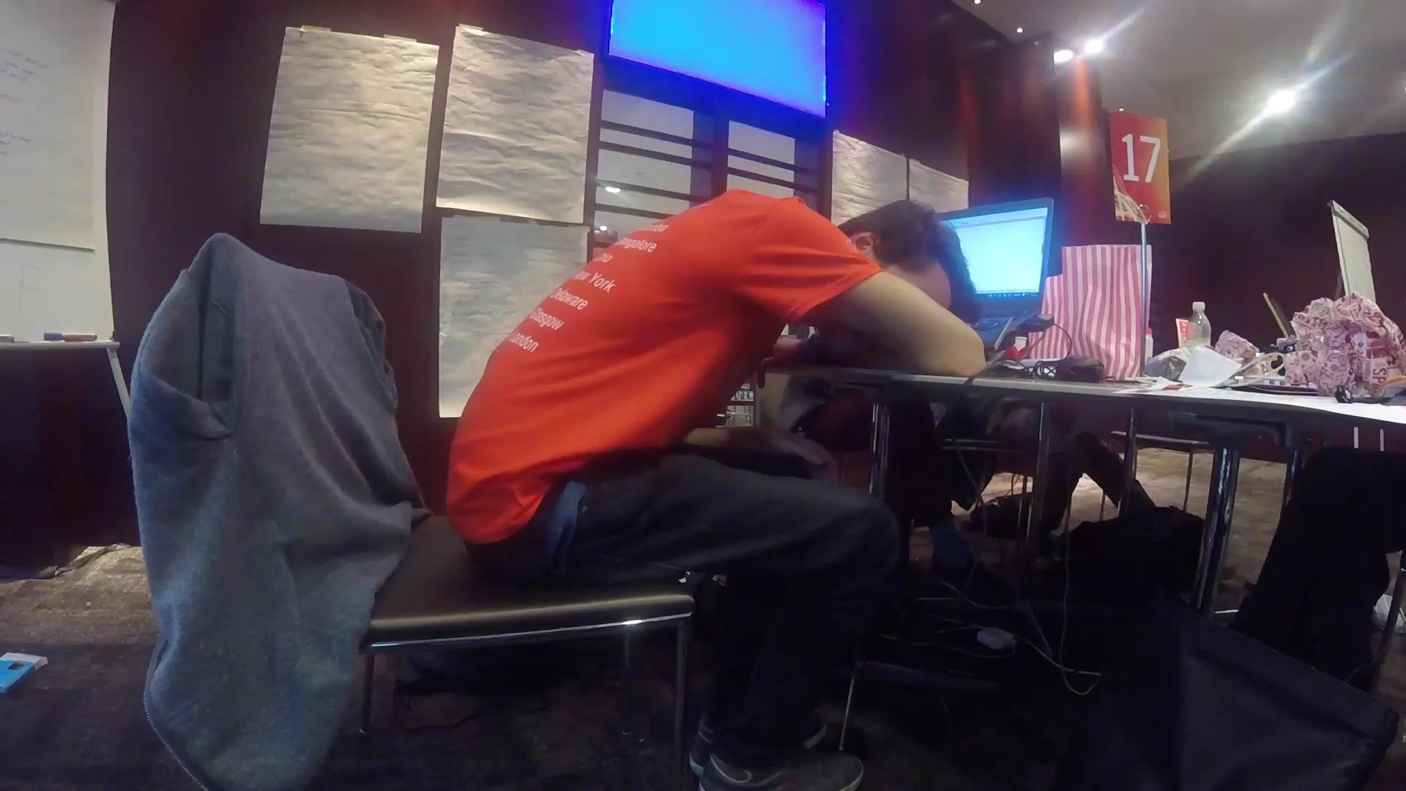

Slide 6
Training Features
\n Easy Stats
\n Possibility to Encourage --> “Static Donations”
\n Possibility to Challenge --> “Dynamic Game”
\n Easily Scalable
Notes:
Training Features

Slide 7
Event Features
\n Visual live feed
+ no need for phones
\n Engagement
+ Private:
-- “Sponsor a part of the track”
-- “Donate & message”
+ Company:
-- “Prizes for milestones”
Notes:
Event Features

Slide 8


Slide 9

SERVER
CLOUD
DB
FIT BIT SU
SCRIPT
WEB APP
API
LOCAL
SOURCE

